Slide 1
LAYOUT IN CSS
NGUYEN NHU TUAN
<tnguyennhu@pentalog.com>

Slide 2
Content
Reset CSS
Table
Elements layout
Float
Layer
Flex

Slide 3
Reset CSS
In case you didn’t know, every browser has its own default ‘user agent’ stylesheet, that it uses to make unstyled websites appear more legible. For example, most browsers by default make links blue and visited links purple, give tables a certain amount of border and padding, apply variable font-sizes to H1, H2, H3 etc. and a certain amount of padding to almost everything. Ever wondered why Submit buttons look different in every browser?
The goal of a reset stylesheet is to reduce browser inconsistencies in things like default line heights, margins and font sizes of headings, and so on.

Slide 4
Table
Tables shouldn't be used for page layouts because they are:
  Slow to render as the browser needs to download most - if not all - of the table to render it properly
  They require more HTML than non-table layouts which means slower loading and rendering, as well as an increased bandwidth usage
  They can be a nightmare to maintain as they can quickly get complex
  They can break text copying
  They negatively affect screen readers and may make your content inaccessible to some users
  They are not as flexible as using proper semantic markup
  They were never intended to be used for page layouts
  Making tables into a responsive layout is very difficult to control
Use a table for tabular data. That's what tables are for.

Slide 5
Elements layout
DIV
Span, P, Ul, Li
H1/H2/…
head, footer, nav, section, article

Slide 6
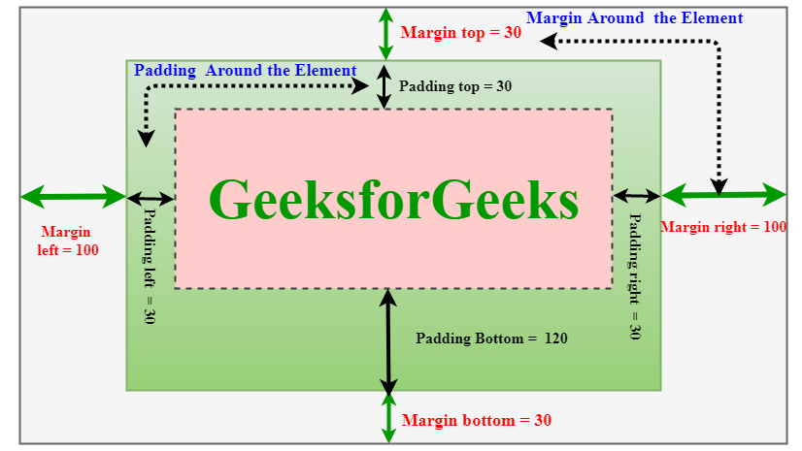
Elements layout
Margin, Padding

Slide 7
Float

Slide 8
Layer

Slide 9
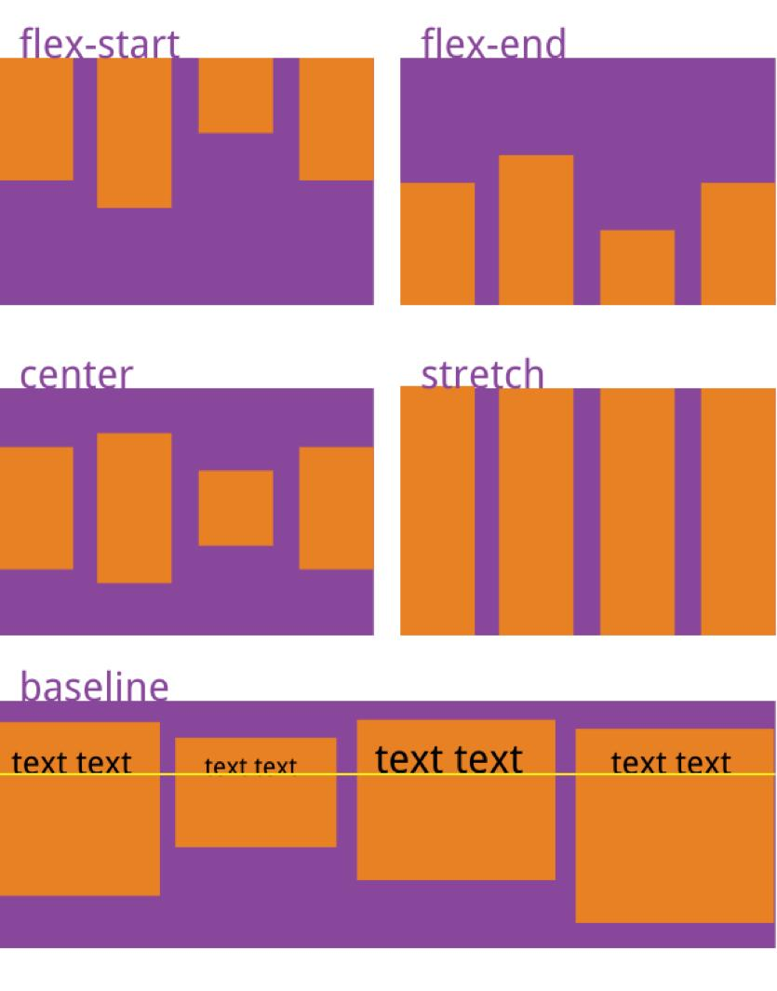
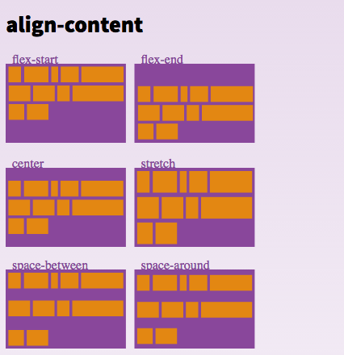
Flex

